Slide 1
2021-2022 웹페이지(Web-Page) 퍼블리싱 기능정의서 & 와이어프레임
김보성
kodory123@naver.com

Slide 2

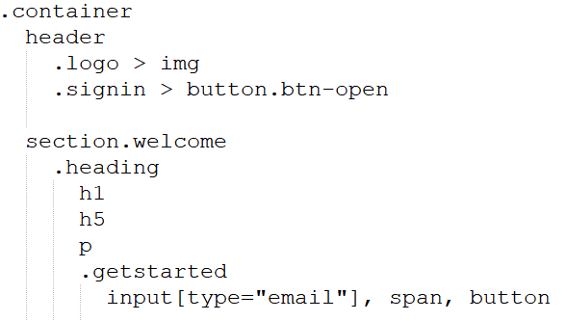
와이어프레임(Wireframe) : 반응형 넷플릭스 공식사이트 [header & welcome & modal]
* : ‘Roboto’ / Body : BGC #000, #fff, 26px / body.active : overflow: hidden (모달 오픈시 스크롤 방지)
Header : width: 100%, z-index: 10 / signin button : bgc #DF2029
Welcome : height: 80vh, bg: url()/ welcome::before : width: 100%, height: 100%, BGC rgba#000, top: 0, left: 0
Heading : width: 800px,
Getstarted : inline-block
input, button : height: 60px, vertical: middle
getstarted input : width: 450px, margin-right: -7px / getstarted button : width: 220px, bgc #DF2029

Slide 3
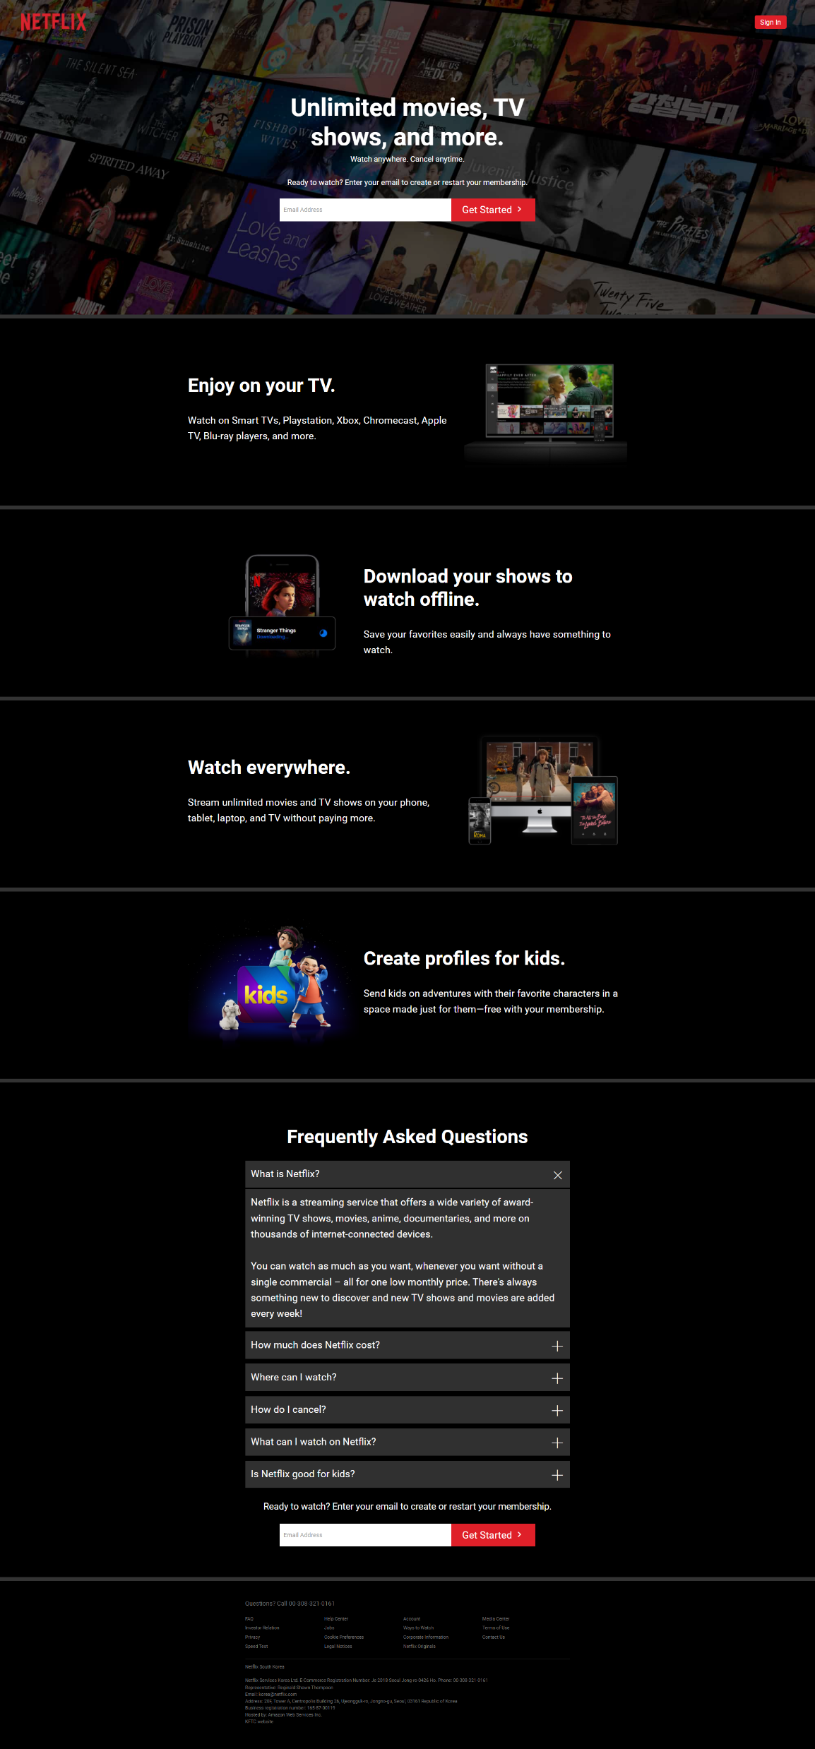
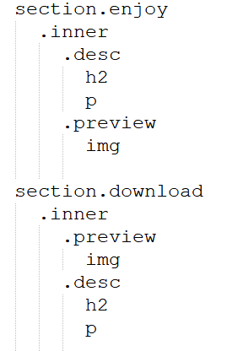
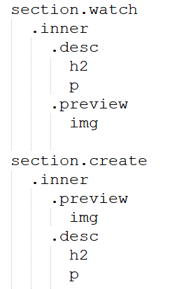
와이어프레임(Wireframe) : 반응형 넷플릭스 공식사이트 [enjoy / download / watch / create]
enjoy, download, watch, create : height: 500px
Inner : width: 1150px, overflow
desc, preview : float: left / desc : width: 60% / preview : width: 40%
Preview img : height : 350px

Slide 4
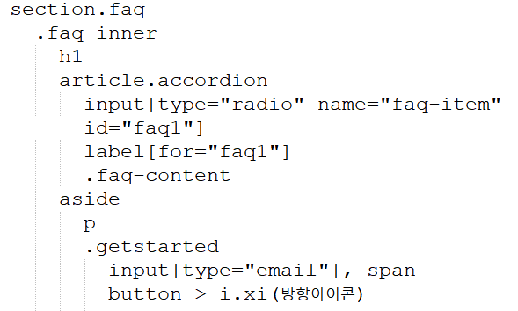
와이어프레임(Wireframe) : 반응형 넷플릭스 공식사이트 [faq]
Faq : padding : 80px 0
Faq-inner : width: 850px
input[name=faq-item] : display:none
input[name=faq-item] + label : block, bgc #303030
input[name=faq-item] + label::after : content: '\e9c5’(+아이콘), right, 36px
input[name=faq-item]:checked + label::after : rotate(45deg)
Faq-content : max-height: 0, overflow, padding: 0, transition: max-height 0.5s
input[name=faq-item]:checked + label + faq-content : max-height: 500px, padding: 15px

Slide 5
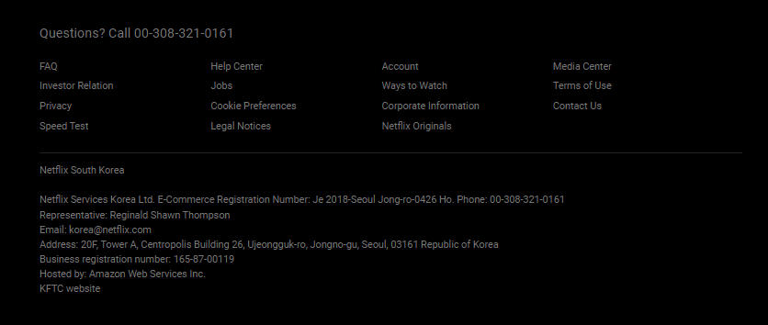
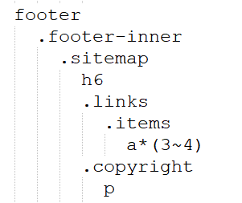
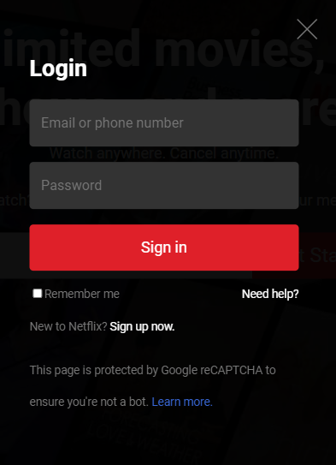
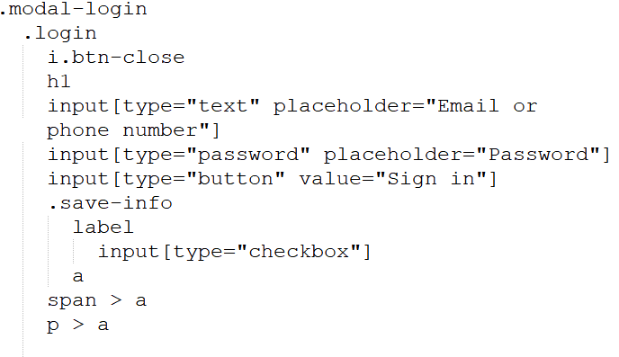
와이어프레임(Wireframe) : 반응형 넷플릭스 공식사이트 [footer & modal]
Footer : padding: 50px 0, 12px, line-height: 1.5em
Footer-inner : width: 850px
Sitemap : border-bottom
Items : inline-block, width: 24%, vertical: top
Modal-login : fixed, width: 100%, height: 100%, BGC rgba #000,
z-index: 100, display: none
Login : bgc: rgba #000, width: 450px
Login input 공통 : bgc#333, width: 100%
Login input button : bgc #DF2029, width: 100%
Save-info label : left / Save-info a : right

Slide 6
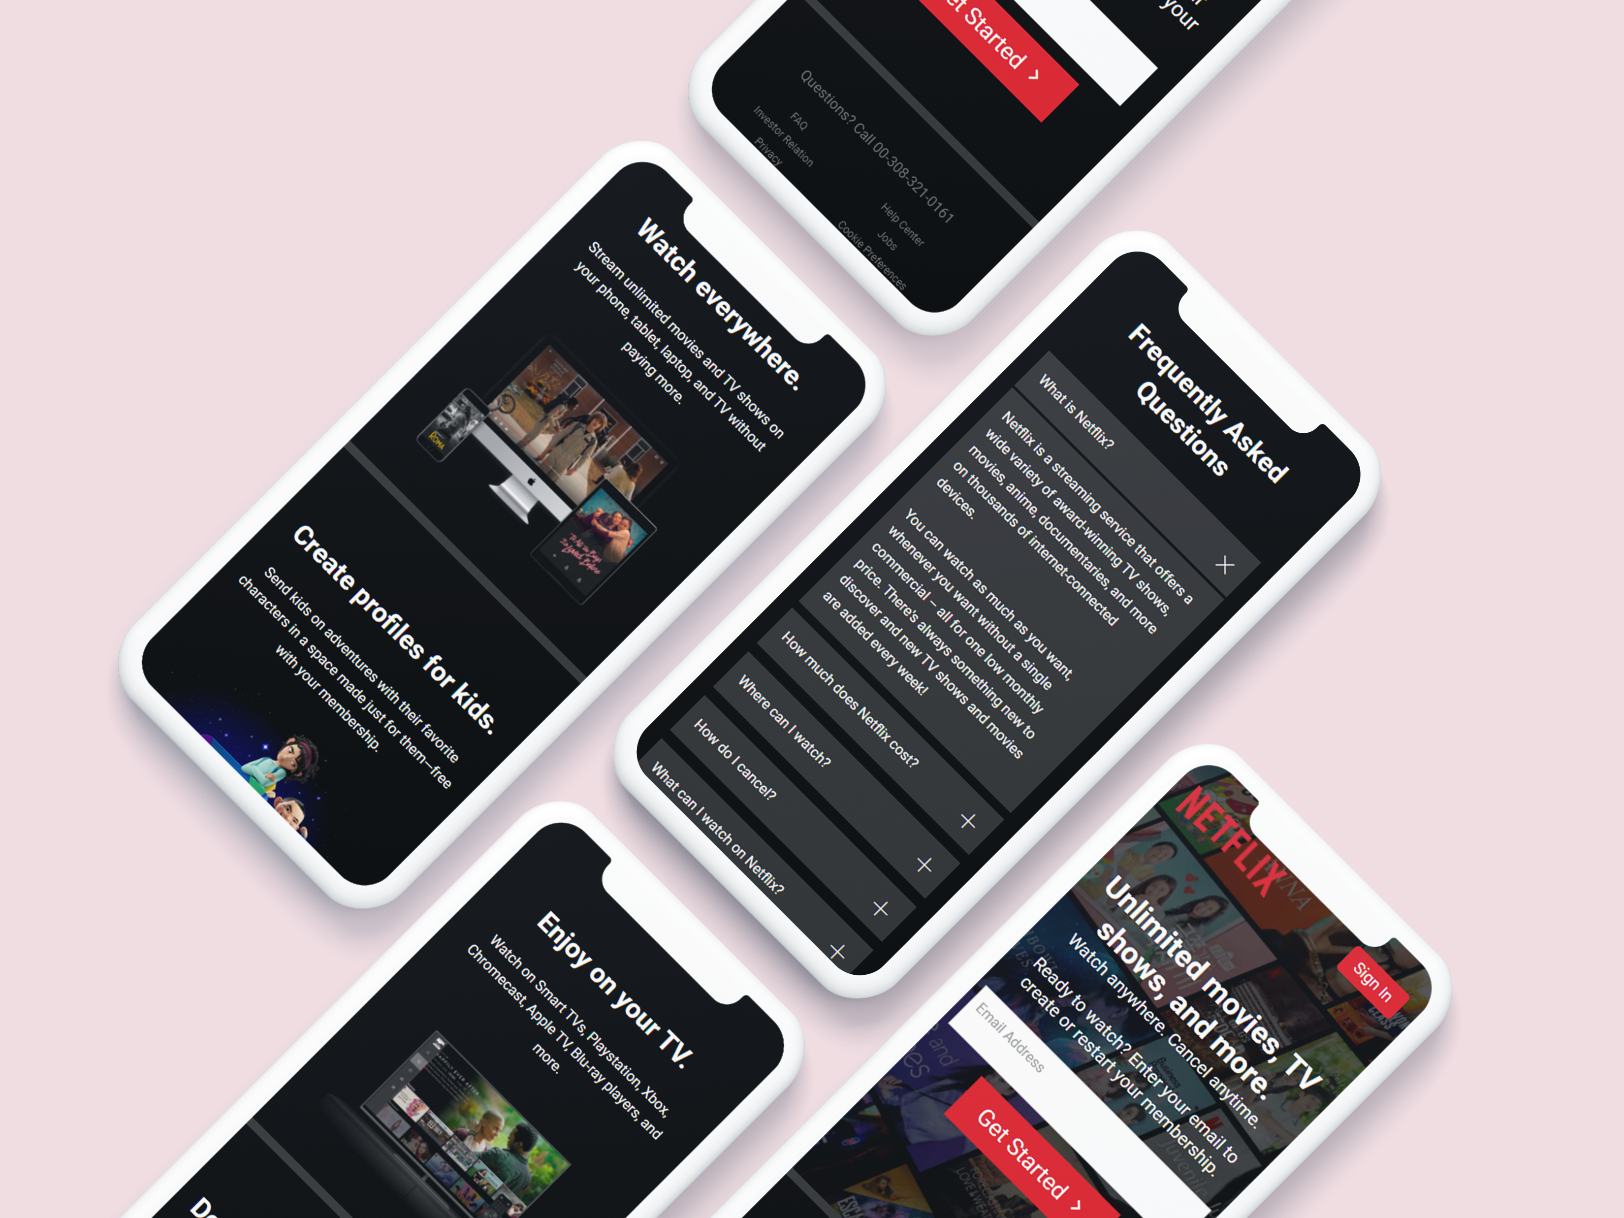
모바일페이지(Mobile-page) : 반응형 넷플릭스 공식사이트

